Slide 1
File Structures and Hashing
Database Design
Chapter 16

Slide 2
Disk Storage Devices
Preferred secondary storage device for high storage capacity and low cost.
Data stored as magnetized areas on magnetic disk surfaces.
A disk pack contains several magnetic disks connected to a rotating spindle.
Disks are divided into concentric circular tracks on each disk surface.
Track capacities vary typically from 4 to 50 Kbytes or more
Solid-state disks are becoming common in data centers

Slide 3
Disk Storage Devices
A track is divided into smaller blocks or sectors
The division of a track into sectors is hard-coded on the disk surface and cannot be changed easily without reformatting the disk
One type of sector organization calls a portion of a track that subtends a fixed angle at the center as a sector.
A track is divided into blocks.
The block size B is fixed for each system.
Typical block sizes range from B=512 bytes to B=4096 bytes.
Whole blocks are transferred between disk and main memory for processing.

Slide 4
Disk Storage Devices

Slide 5
Disk Storage Devices
A read-write head moves to the track that contains the block to be transferred.
Disk rotation moves the block under the read-write head for reading or writing.
A physical disk block (hardware) address consists of:
a cylinder number (collection of tracks of same radius from all recorded surfaces)
the track number or surface number (within the cylinder)
and block number (within track)
Logically, the operating system translates an offset from the beginning of a file to a physical address

Slide 6
Disk Storage Devices
Reading or writing a disk block is time consuming because of the seek time and rotational delay (latency) rd.
Double buffering can be used to speed up the transfer of contiguous disk blocks.

Slide 7
Records
Also called “rows” in a database
Can be fixed-length (fairly common) or variable-length
Fields can be fixed-length (char, int) or variable-length (varchar)
Records can contain both fixed-length and variable-length fields
Separator characters or offset lists used to store variable-length fields
Records in most systems can contain “BLOBs,” binary data such as pictures, documents, and even programs

Slide 8
Database File Structure
Databases are usually stored in a single disk file
The file contains all of the metadata and data for the database
The first block in the file contains metadata and possibly the disk addresses of additional blocks of metadata
Metadata includes the names of all of the tables, the fields in each table, stored procedures, triggers, constraints, etc.

Slide 9
Database File Structure
Blocking refers to storing a number of data records in one block on the disk
Typical block size is either a sector or some number of sectors that is a power of 2 (2, 4, 8, etc.)
Blocking factor (bfr) refers to the number of records per block.
There may be empty space in a block if an integral number of records do not fit in one block.
Spanned Records:
Refers to records that exceed the size of one or more blocks and hence span a number of blocks

Slide 10
Database File Structure
Actual data is stored in blocks, per above
Fixed-length records all have the same format. Usually, unspanned blocking is used with such files.
Files of variable-length records require additional information to be stored in each record, such as separator characters and field types.
Usually spanned blocking is used with such files.

Slide 11
Basic File Operations
OPEN: Readies the file for access, and associates a pointer that will refer to a current byte position in the file at each point in time
READ: Reads a specific number of bytes into memory
Write: Write a specific number of bytes from memory into the current position in the file
SEEK: Change the pointer for the next read or write operation
CLOSE: Terminates access to the file

Slide 12
Database File Operations
FIND: Searches for the first file record that satisfies a certain condition, and makes it the current file record.
FINDNEXT: Searches for the next file record (from the current record) that satisfies a certain condition, and makes it the current file record.
REORGANIZE: Reorganizes the file records.
For example, the records marked deleted are physically removed from the file or a new organization of the file records is created.
READ_ORDERED: Read the file blocks in order of a specific field of the file.
INSERT: Inserts a new record into the file & makes it the current file record.
DELETE: Removes the current file record from the file, usually by marking the record to indicate that it is no longer valid.
MODIFY: Changes the values of some fields of the current file record.

Slide 13
Unordered Files
Also called a heap or a pile file
New records are appended to the end of the file
A linear search through the file records is necessary to search for a record
This requires reading and searching half the file blocks on the average, and is hence quite expensive.
Record insertion is quite efficient
Reading the records in order of a particular field requires sorting the file records

Slide 14
Ordered Files
Also called a sequential file
File records are kept sorted by the values of an ordering field
Insertion is expensive: records must be inserted in the correct order
It is common to keep a separate unordered overflow (or transaction) file for new records to improve insertion efficiency; this is periodically merged with the main ordered file
A binary search can be used to search for a record on its ordering field value
This requires reading and searching log₂ of the file blocks on the average, an improvement over linear search
Requires that the records be of fixed length
Reading the records in order of the ordering field is quite efficient
Notes:
Binary search requires that the records be fixed-length

Slide 15
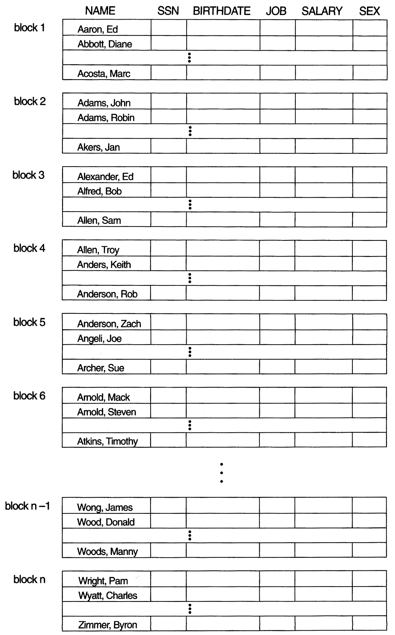
An Ordered File

Slide 16
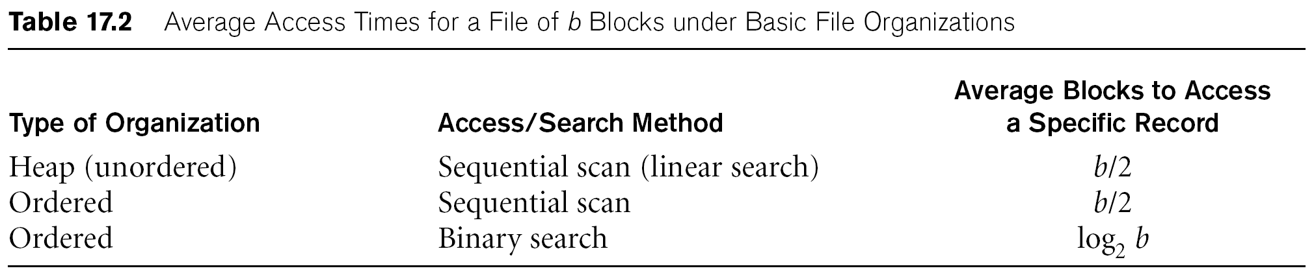
Average Access Times
The following table shows the average access time to access a specific record for a given type of file

Slide 17
Hashed Files
Hashing for disk files is called External Hashing
The file blocks are divided into M equal-sized buckets, numbered bucket₀, bucket₁, ..., bucket_{M-1}.
Typically, a bucket corresponds to one (or a fixed number of) disk block.
One of the file fields is designated to be the hash key of the file.
The record with hash key value K is stored in bucket i, where i=h(K), and h is the hashing function.
Search is very efficient on the hash key.
Collisions occur when a new record hashes to a bucket that is already full.
An overflow file is kept for storing such records.
Overflow records that hash to each bucket can be linked together.
Notes:
In a database, the hash blocks are in the same file with everything else

Slide 18
Hashed Files
There are several methods for collision resolution, including the following:
Open addressing: Proceeding from the occupied position specified by the hash address, the program checks the subsequent positions in order until an unused (empty) position is found.
Chaining: For this method, various overflow locations are kept, usually by extending the array with a number of overflow positions. In addition, a pointer field is added to each record location. A collision is resolved by placing the new record in an unused overflow location and setting the pointer of the occupied hash address location to the address of that overflow location.
Multiple hashing: The program applies a second hash function if the first results in a collision. If another collision results, the program uses open addressing or applies a third hash function and then uses open addressing if necessary.

Slide 19
Hashed Files

Slide 20
Hashed Files
To reduce overflow records, a hash file is typically kept 70-80% full.
The hash function h should distribute the records uniformly among the buckets
Otherwise, search time will be increased because many overflow records will exist.
Main disadvantages of static external hashing:
Fixed number of buckets M is a problem if the number of records in the file grows or shrinks.
Ordered access on the hash key is quite inefficient (requires sorting the records).

Slide 21
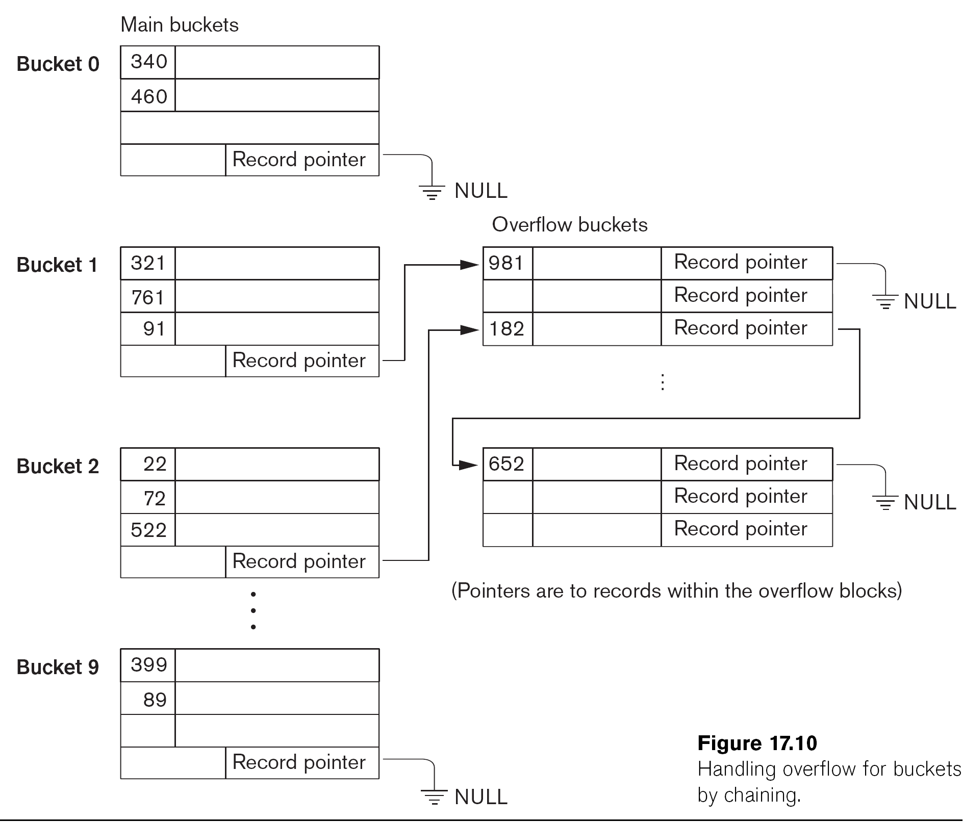
Hashed Files – Overflow Handling

Slide 22
Dynamic and Extendible Hashing
Dynamic and Extendible Hashing Techniques
Hashing techniques are adapted to allow the dynamic growth and shrinking of the number of file records.
These techniques include the following: dynamic hashing, extendible hashing, and linear hashing.
Both dynamic and extendible hashing use the binary representation of the hash value h(K) in order to access a directory.
In dynamic hashing the directory is a binary tree.
In extendible hashing the directory is an array of size 2^{d} where d is called the global depth

Slide 23
Dynamic and Extendible Hashing
The directories can be stored on disk, and they expand or shrink dynamically.
Directory entries point to the disk blocks that contain the stored records.
An insertion in a disk block that is full causes the block to split into two blocks and the records are redistributed among the two blocks.
The directory is updated appropriately.
Dynamic and extendible hashing do not require an overflow area.
Linear hashing does require an overflow area but does not use a directory.
Blocks are split in linear order as the file expands.

Slide 24
Extendible Hashing

Slide 25
Summary
Disk Storage Devices
Files of Records
Operations on Files
Unordered Files
Ordered Files
Hashed Files
Dynamic and Extendible Hashing Techniques

